Slide 1

Chapter 4 Integration (积分)
In this Chapter, we will know some important concepts.
Antiderivatives
Sums and Sigma Notation (求和记号)
The Definite Integral (定积分)
The Fundamental Theorem of Calculus
(微积分基本定理)
Integration by Substitution (换元积分法)

Slide 2
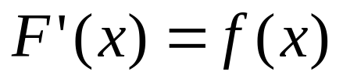
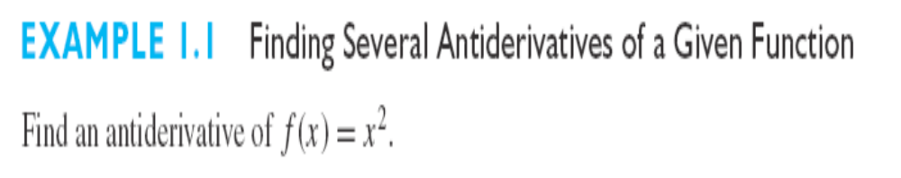
Section 4.1 Antiderivative
Antidifferentiation: A function F(x) is said to be an antiderivative of f(x) if
for every x in the domain of f(x). The process of finding antiderivatives is called antidifferentiation or indefinite integration.

Slide 3
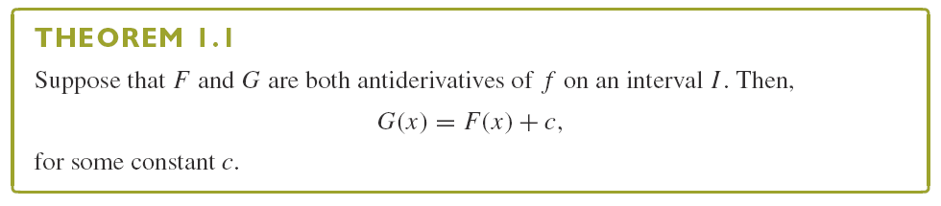
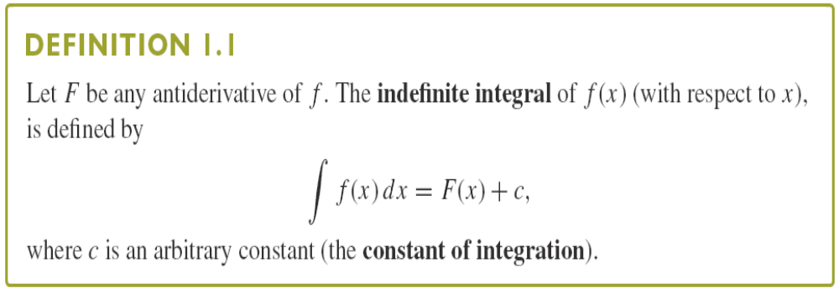

Slide 4
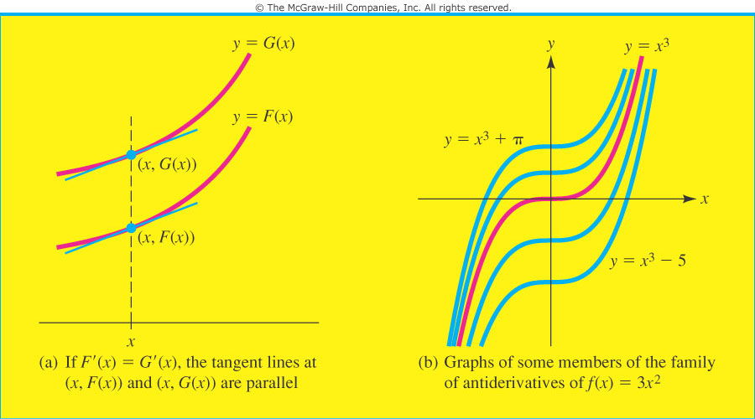
The process of computing an integral is called integration. Here, f(x) is called the integrand and the term dx identifies x as the variable of integration.

Slide 5
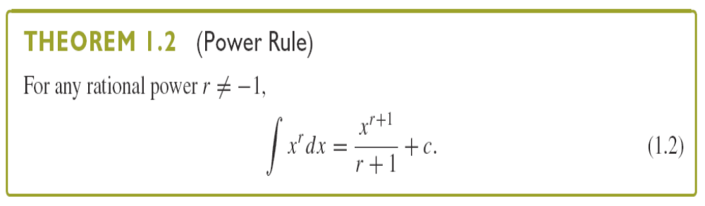

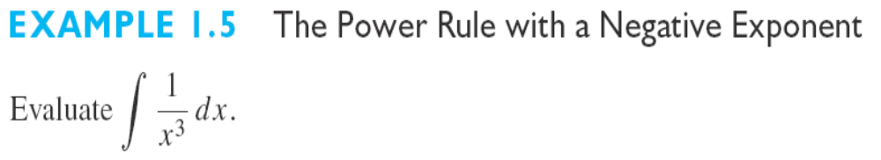
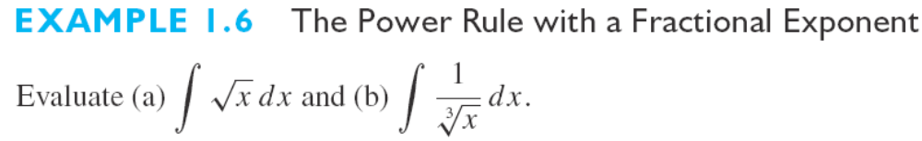

Slide 6
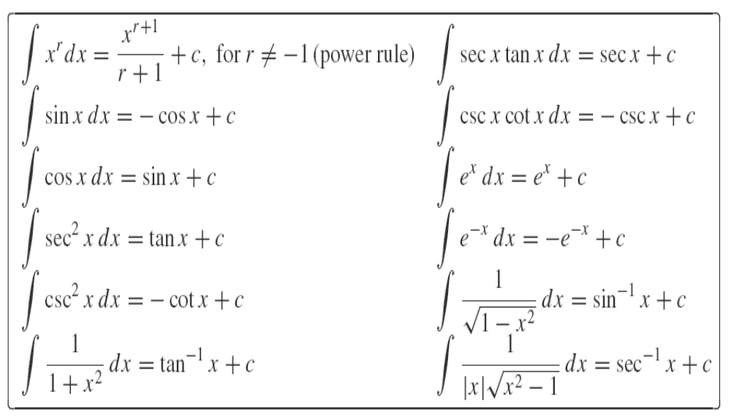

Slide 7
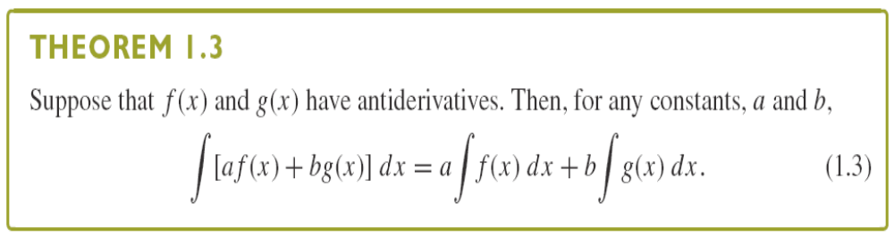

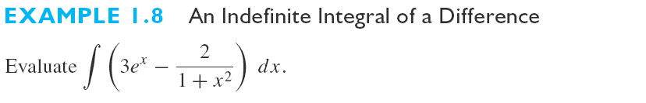

Slide 8
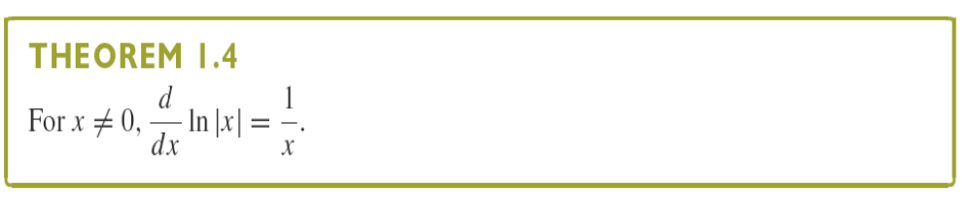
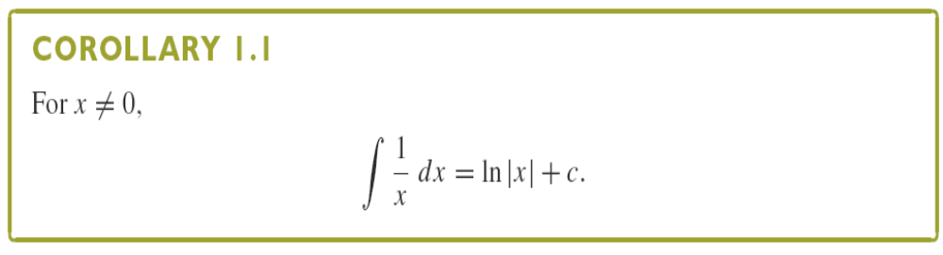

Slide 9
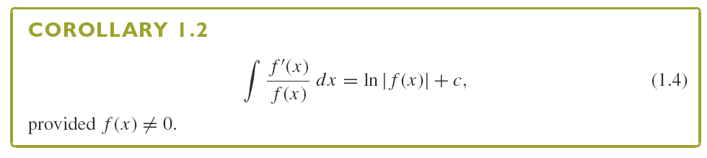
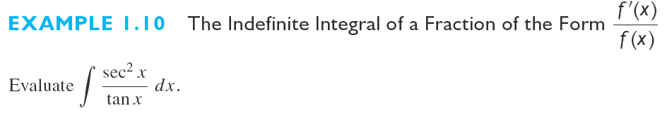

Slide 10
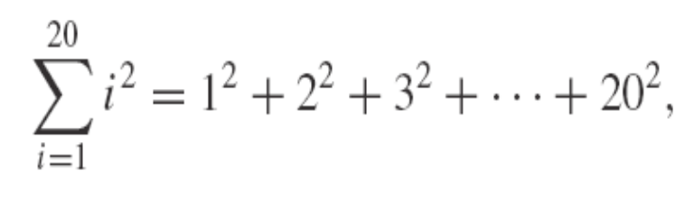

Section 4.2 Sums and Sigma Notation (求和记号)
We use the Greek capital letter sigma, ∑, as a symbol for sum and write the sum in summation notation as
to indicate that we add together terms of the form
, starting with i=1 and ending with i=20. The variable i is called the index of summation

Slide 11
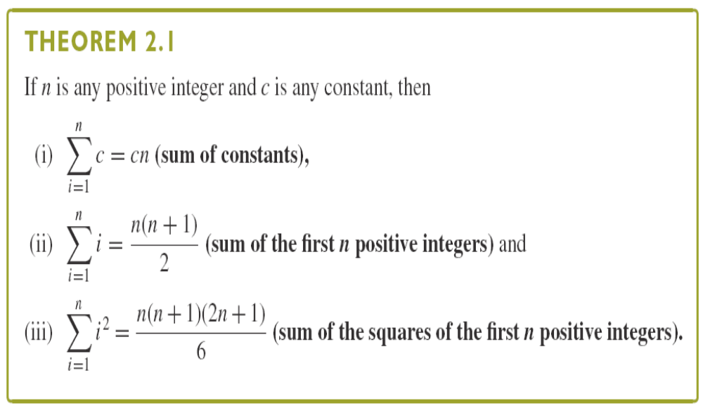

Slide 12
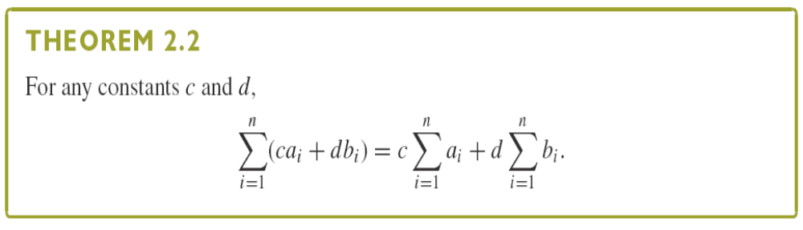
Principle of Mathematical Induction (数学归纳法)

Slide 13
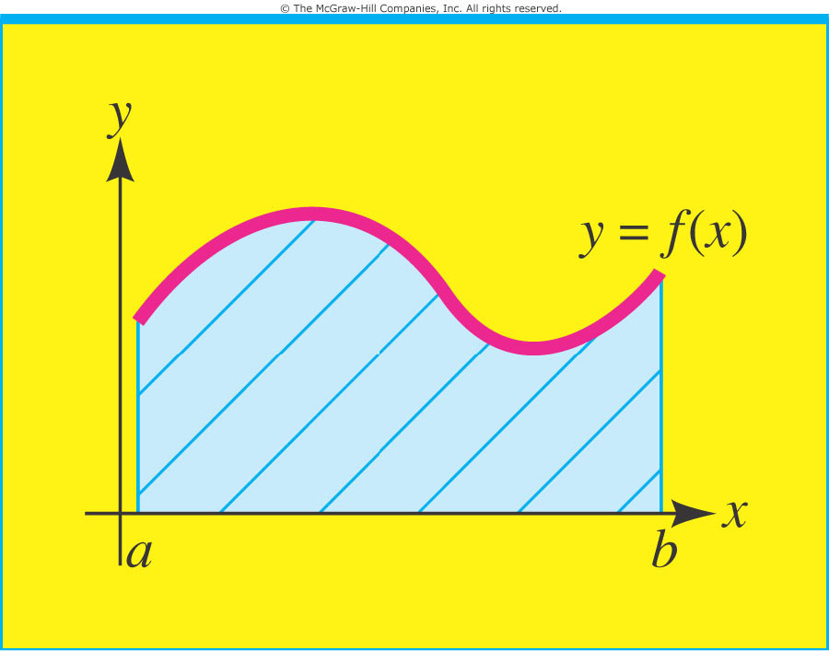
Section 4.3 Area (面积)
Our goal in this section is to show how area under a curve can be expressed as a limit of a sum of terms called a definite integral.

Slide 14
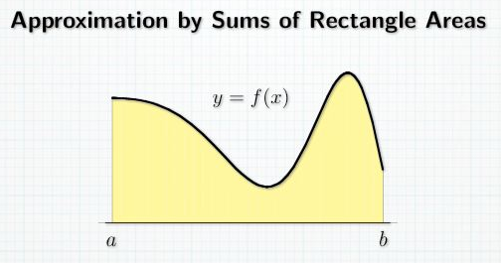
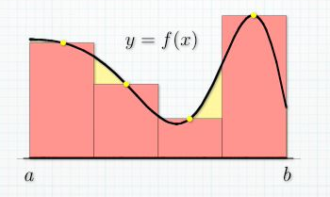
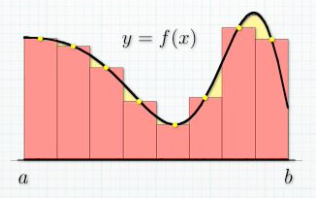



Slide 15
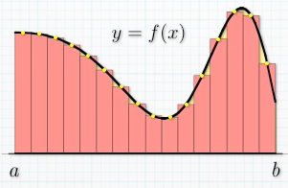
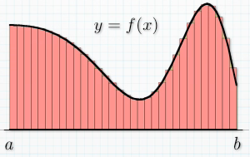


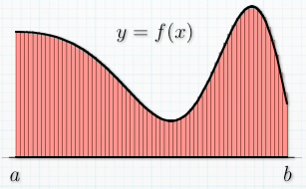




Slide 16

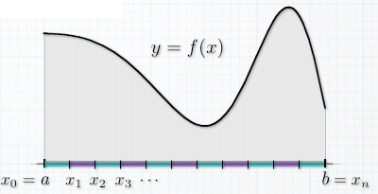

All rectangles
have same width.
n subintervals:
Subinterval width
Formula for x_{i}:

Slide 17
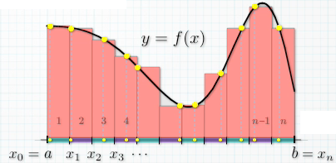
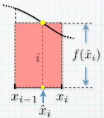



Choice of n evaluation points

Slide 18
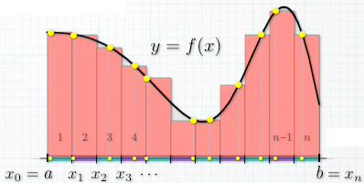
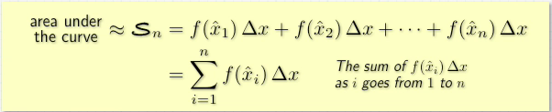

Slide 19

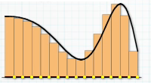
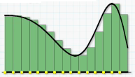



Right-endpoint approximation
left-endpoint approximation

Slide 20
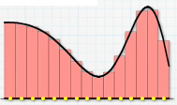


Midpoint Approximation

Slide 21


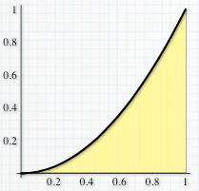
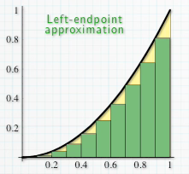

Example 11
=0.285
to be continued

Slide 22
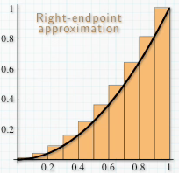
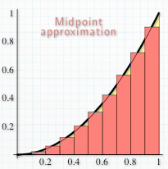



=0.39
=0.33

Slide 23




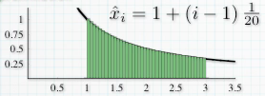


Example 12
left-endpoint approximation
to be continued

Slide 24




Right-endpoint approximation
to be continued

Slide 25
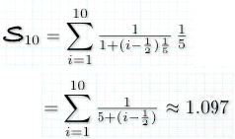



Midpoint Approximation

Slide 26
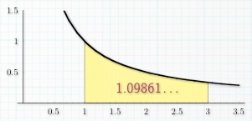
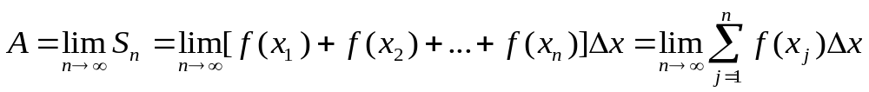

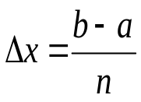
Area Under a Curve Let f(x) be continuous and satisfy f(x)≥0 on the interval a≤x≤b. Then the region under the curve y=f(x) over the interval a≤x≤b has area
Where is the point chosen from the jth subinterval if the Interval a≤x≤b is divided into n equal parts, each of length

Slide 27
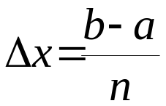

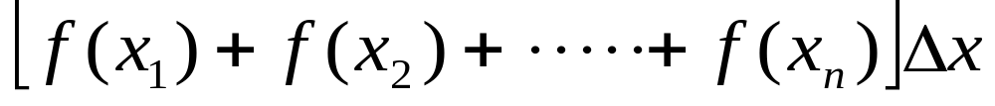
Riemann sum Let f(x) be a function that is continuous on the interval a≤x≤b. Subdivide the interval a≤x≤b into n equal parts, each of width , and choose a number from the kth subinterval for k=1, 2, …, . Form the sum
Called a Riemann sum （黎曼和）.
Note: f(x)≥0 is not required

Slide 28
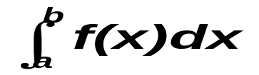

Section 4.4 The Definite Integral (定积分)
The Definite Integral the definite integral of f on the interval a≤x≤b, denoted by , is the limit of the Riemann sum as n→+∞; that is
The function f(x) is called the integrand, and the numbers a and b are called the lower and upper limits of integration, respectively. The process of finding a definite integral is called definite integration.
Note: if f(x) is continuous on a≤x≤b, the limit used to define
integral exist and is same regardless of how the subinterval representatives xk are chosen.

Slide 29
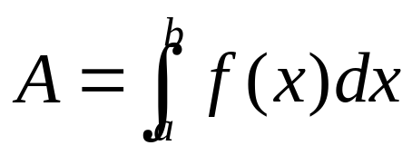
Area as a Definite Integral: If f(x) is continuous and f(x) ≥0 on the interval a≤x≤b, then the region R under the curve y=f(x) over the interval
a≤x≤b has area A given by the definite integral

Slide 30
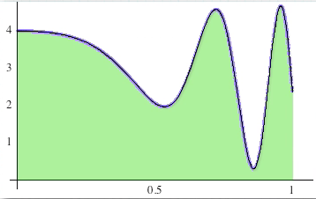
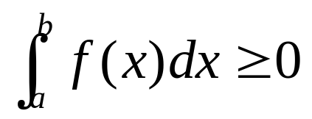
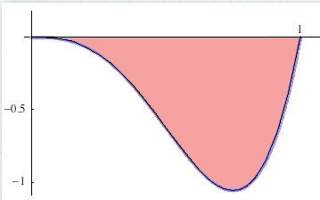

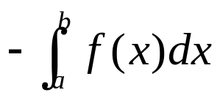
If f(x) is continuous and f(x)≥0 for all x in [a,b],then
and equals the area of the region bounded by the graph f and the x-axis between x=a and x=b
If f(x) is continuous and f(x)≤0 for all x in [a,b],then
And equals the area of the region bounded by the graph f and the x-axis between x=a and x=b

Slide 31



equals the difference between the area under the graph
of f above the x-axis and the area above the graph of f below the
x-axis between x=a and x=b.
This is the net area of the region bounded by the graph of f and
the x-axis between x=a and x=b.

Slide 32




Example

Slide 33



Slide 34




Slide 35




Slide 36


The Average Value of Function
The average value of a Function Let f(x) be a function that is continuous on the interval a≤x≤b. Then the average value V of f(x) over a≤x≤b is given by the definite integral

Slide 37


Average value of a Function
Suppose that f is continuous on [a,b] , what is average value of the function f(x) over the interval a≤x≤b?
1. Subdivide the interval a≤x≤b into n equal parts
2. Choose x_{j} from the jth subinterval for j=1,2…,n. Then the
average of corresponding functional value f(x₁), f(x₂), …f(x_{n}) is

Slide 38





Riemann Sum

Slide 39


3. Refine the partition of the interval a≤x≤b by taking more and more subdivision Points. Then Vn becomes more and more like the average value of V over the interval [a,b].The average value V can be think as the limit of the Riemann sum V_{n} as n→∞. That is ,

Slide 40


Geometric Interpretation of Average Value The average value V
of f(x) over an interval a≤x≤b where f(x) is continuous and
satisfies f(x)≥0 is equal to the height of a rectangle whose base is
the interval and whose area is the same as the area under the
curve y=f(x) over a≤x≤b .
The rectangle with base a≤x≤b and height V has the same area as the region under the curve y=f(x) over a≤x≤b .

Slide 41

Integral Mean Value Theorem (积分中值定理)

Slide 42


Section 4.5 The Fundamental Theorem of Calculus(微积分基本定理)

Slide 43




Slide 44





Slide 45


Slide 46



Slide 47

Example

Slide 48

Example

